Slide 1

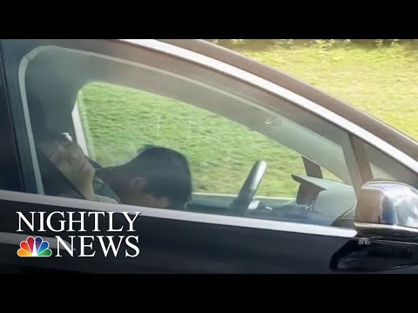

Module 1.6, Case Study #1:
Sleeping Drivers in Self-Driving Cars
Living and Working with Artificial Intelligence
Developed for the AI4GA (Artificial Intelligence for Georgia) project funded by National Science Foundation awards DRL-2049029 and DRL-2048502.
This work is licensed under the Creative Commons Attribution-NonCommercial-ShareAlike 4.0 International License. https://creativecommons.org/licenses/by-nc-sa/4.0/

Slide 2
Learning Objectives
Students should be able to:
Describe social and ethical issues of autonomous vehicles
Describe the benefits and harmful impacts of autonomous vehicles
Consider multiple perspectives when evaluating AI technology

Slide 3
Video: Tesla Driver Caught On Camera Apparently Asleep At The Wheel | NBC Nightly News
As you watch the video,
think about
What do you find interesting or surprising?
What do the producers of the video want you to learn?
https://www.youtube.com/watch?v=NHUZxeSUFUk (1:35)
Notes:
Teacher Notes:
Possible surprising/interesting
That the car is able to drive without causing an accident while the drivers are sleeping
How long the drivers were able to sleep
The driver’s seat seemed to be reclined
What did you learn/producers want you to learn
Tesla has sensors that warn you if your hands come off the steering wheel - light and alarm
The car will continue to drive in self-driving mode even if your hands come of the wheel

Slide 4
Video: Tesla Driver Caught On Camera Apparently Asleep At The Wheel | NBC Nightly News
Let’s watch it again
Is the human using the self-driving car as it was intended?
Is this responsible behavior?
Is this behavior legal?
Is it safe behavior?
Are the sensors operating properly?
https://www.youtube.com/watch?v=NHUZxeSUFUk (1:35)

Slide 5
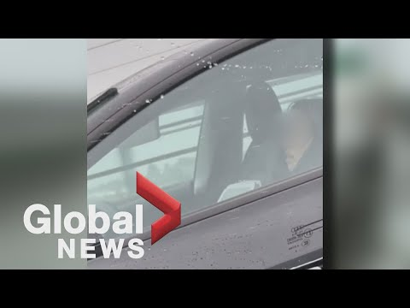
Video: Video shows Tesla driver seemingly asleep at the wheel on a BC bridge during rush hour
Let’s watch a new video and keep these questions in mind
Is the human using the self-driving car as it was intended?
Is this responsible behavior?
Is this behavior legal?
Is it safe behavior?
Are the sensors operating properly?
https://www.youtube.com/watch?v=WQyliOXgNnc (2:13)

Slide 6
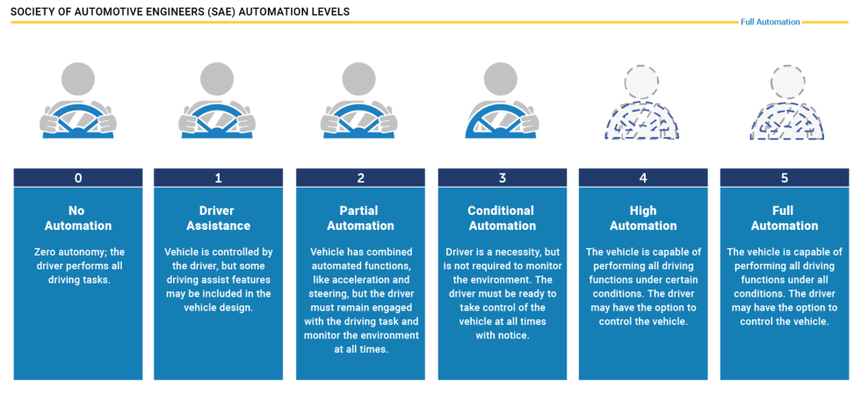
What level of autonomy is Tesla’s Autopilot mode?
Notes:
Source: https://www.sciencealert.com/tesla-driver-caught-sleeping-for-more-than-30-miles-on-one-of-california-s-busiest-freeways
Teacher Note: Data Collection: Student artifact - Have students answer this question and explain their answer.

Slide 7
What level of autonomy is Tesla’s Autopilot mode?
Student ID# ____________________
Instructions: Circle your answer below and explain why
Notes:
Source: https://www.sciencealert.com/tesla-driver-caught-sleeping-for-more-than-30-miles-on-one-of-california-s-busiest-freeways
Teacher Note: Data Collection: Student artifact - Have students answer this question and explain their answer.

Slide 8

What level of autonomy is Tesla’s Autopilot mode?
Tesla’s Operating Requirement for Drivers
Vehicles
Capability
Notes:
https://www.sciencealert.com/tesla-driver-caught-sleeping-for-more-than-30-miles-on-one-of-california-s-busiest-freeways

Slide 9
What level of autonomy do you think sleeping drivers associate with Tesla’s Autopilot mode?
Student ID# ____________________
Instructions: Circle your answer below and explain why
Notes:
https://www.sciencealert.com/tesla-driver-caught-sleeping-for-more-than-30-miles-on-one-of-california-s-busiest-freeways

Slide 10

What level of autonomy do you think sleeping drivers associate with Tesla’s Autopilot mode?
Tesla’s Operating Requirement for Drivers
Sleeping Owner’s possible perception of vehicle’s capability & safety
Vehicles
Capability
Notes:
https://www.sciencealert.com/tesla-driver-caught-sleeping-for-more-than-30-miles-on-one-of-california-s-busiest-freeways

Slide 11
Is there a moral hazard? For who?
A “moral hazard” is a lack of incentive to guard against risks where one is protected from its consequences, e.g., by insurance.
Tesla’s Operating Requirement for Drivers
Vehicle’s
Capability
Sleeping Owner’s possible perception of vehicle’s capability & safety
Notes:
Source: https://www.sciencealert.com/tesla-driver-caught-sleeping-for-more-than-30-miles-on-one-of-california-s-busiest-freeways
Teacher note: Owners have to have to agree not to misuse the autopilot mode. The moral hazard is that Tesla can choose to rely on the owners’ promises even though they know that a certain percentage of them are lying. They are using this reliance to justify the release of autopilot mode in its unfinished and therefore dangerous state.

Slide 12
Ethical Reflection: Is it enough to warn people not to do something even though you know they won’t listen?
Yes, explain why
No, explain why

Slide 13
Is Tesla’s Autopilot mode an attractive nuisance?
Basic Elements of Attractive Nuisance
A potentially dangerous condition exists on the property.
The landowner created or maintained the potential hazard.
The landowner should have known the condition would attract children.
The landowner should have known the condition could harm children.
Examples:
Swimming pools
Trampolines
Tree houses
Fountains
Machinery (lawnmowers, gasoline pumps, etc.)
Wells
Tunnels
Dangerous animals
Perspective: Given this definition of “attractive nuisance”, do you consider Tesla’s Autopilot mode a type of attractive nuisance? Why?

Slide 14
Policy Reflection: Should Autopilot Mode be banned?
Directions: Write down several reasons for banning or not banning auto pilot mode
Yes, explain why
No, explain why
Perspective: Which view do you support and why?

Slide 15
Reflection: Do you think the penalty drivers received for sleeping while their car is driving in autopilot mode is appropriate given the possible safety risks?
Directions: What are the penalties? Are they appropriate?
Yes, explain why
No, explain why
Perspective: Which view do you support and why?
Notes:
Teacher Note: Both video provide some answers about the consequences. Student can do a little research to answer this question.

Slide 16
Knowing what you know, would you put your grandparents in a self-driving car?

Slide 17

Meet engineers who created a self-driving car

Slide 18
Deeper Dive: What are the driver assistance features of Tesla’s Cars?
Read: https://www.tesla.com/support/autopilot
Auto-Pilot Mode Features
Fully Autonomous Mode Features

Slide 19
Optional: Resources
Additional Videos
Driver asleep at the wheel of his Tesla on busy freeway in Los Angeles
Tesla Driver Pulled Over After Appearing To Be Asleep While Driving
Tesla Owner Caught Sleeping Behind The Wheel On Autopilot (20 minutes, bodycam)

